Slide 1
DASR 139 Implementation Overview
Presented by: GPCAPT David Flood and Mr Dan Grosse
Date: 04 Aug 20
Notes:
Welcome
Intro team
ROE
Introductory course not practitioner.
Not going into specific cases and if there specific examples then we will take them outside of this presentation.

Slide 2
Scope
Defence aviation safety environment structure and regulations
DASR 139 organisation and approvals
Aerodrome operator
Aerodrome approval
  Aerodrome Manual
  Aerodrome Certification
What is coming
The DASA mission is:
“to support aviation commanders and assure a credible and defensible level of aviation safety”.
Notes:
Background as to why we regulate
Overview of artefacts and processes
Generic discussion AD OPR and AD approval
What is coming
Note DASA mission, support commanders and that is what we are here to do.

Slide 3
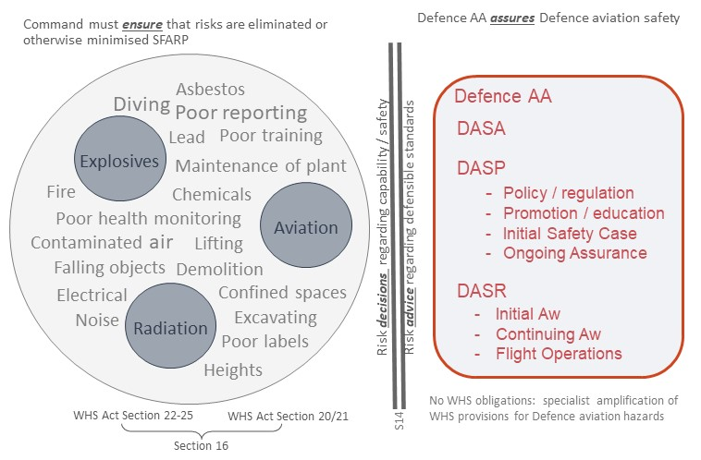
WHS & Defence Aviation Safety
Notes:
This slide shows why we regulate Defence aviation
WHS covers safety in the work but has limitations in some environments
There is additional Commonwealth legislation for explosives, radiation and aviation.
The aviation legislation is civil only – following ICAO
For to meet duty of care requirements Defence self-regulates for aviation safety to fill the void
SEC/CDF have appointed CAF as the Defence AA, directing the establishment of the DASA, the DASP and other activities that provide them assurance of Defence aviation safety
Commanders and managers implement the safety system and ensure risks are eliminated SFARP and if not then minimised SFARF
S14 ‘Duties not transferable’ is eight words ‘A duty cannot be transferred to another person’ or as stated in the Haddon-Cave report – you cannot outsource accountability.
(IF ASKED - S16 is about more than one person can have an accountability and S20-25 discusses how that happens)

Slide 4
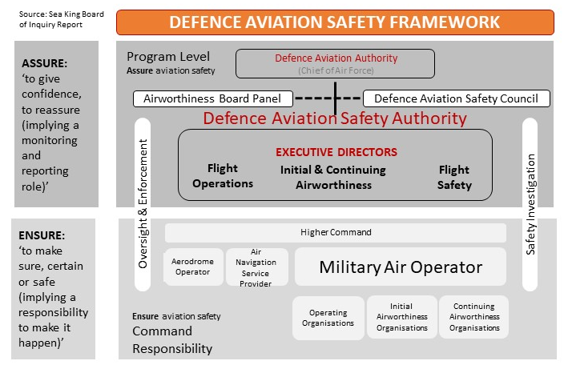
Defence Aviation Safety Framework
Notes:
The large dark grey box shows what SEC/CDF has directed CAF to establish as the Defence AA
Complete with two independent bodies that report direct to the Defence AA (ACPA provides secretarial and administrative support)
The large light grey box represents those conduct Defence aviation activities
Includes Army, Navy, Air Force, APS and contractors
Oversight and enforcement with safety investigations is conducting in and by both areas
The group in the first box under higher command is the focus of this presentation
The regulations do not usurp command authority. Command can restrict a subordinate within DASR; however, if they want to authorise operations outside of DASR then they need to start talking with DASA, within the allowed exception being issuing a command clearance that is allowed within DASR.
Sea King BOI raised the difference between ensure and assure responsibilities, as did Haddon-Cave and finally WHS Act 2011 – a common theme

Slide 5
Defence Aviation Safety
Aviation Safety is the state in which risks to personnel arising from aircraft operations are eliminated or minimised so far as reasonably practicable through a continuing process of hazard identification and safety risk management.
In the Defence context, aviation safety encompasses both the manner in which aircraft are flown, and the tasks, activities and management systems whose primary purpose is to enable safe flight.
Source: JD 24/2016
Notes:
Out of SEC/CDF Directive, what we are aiming to achieve, the how (WHS compliant) and scope.

Slide 6
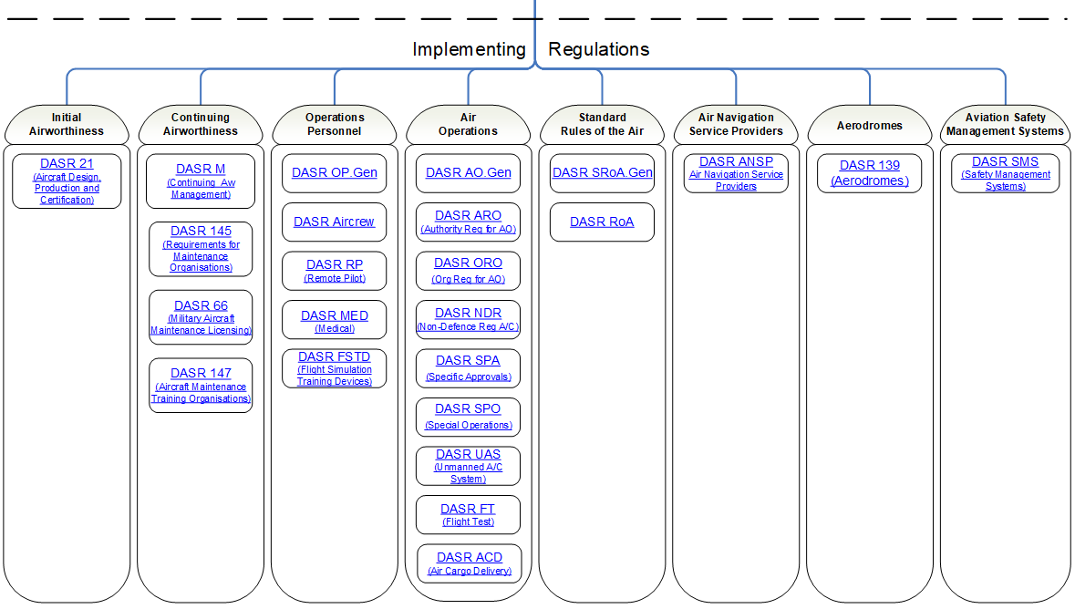
DASR Structure
Basic Regulation
Airworthiness Regulations
Flight Operations
SMS
EASA Aligned
Military Operations
SMS
6
Notes:
What the DASR look like on the web site in app called Author IT.
BR tells DASA what should be regulated – adapted from EASA BR.
Build
First two columns are Initial and Continuing Airworthiness based on European regulations. The next three are about Air Ops based on pre DASR regulations. The first five are all about aircraft – not relevant to today’s brief.
The next two are what were previously known as Aviation Support System. The first is Air Navigation Service Providers and the second, the subject of today’s brief, is Aerodromes.
The last column is Safety Management System. There were two options considered when developing DASR in 2016. One was to embed safety regulation requirements throughout the regulations; however, as you can the SMS requirements are separate and reflect back through the regulation suite. I understand and additional doughnut is being developed to go in the SMS column for fatigue management.
Build
The two regulations relevant to this brief are DASR 139 (Aerodromes) and DASR SMS.
The other regulation that is probably of interest to some is UAS as they become more prolific. Limitations around an aerodrome are in there

Slide 7
DASA’s Regulatory Philosophy
Regulations exist to deal with hazards
  No hazard / No regulation required
  If adequate in WHS – no need in DASR
Outcome-based
  The regulation defines the ‘what’
  Regulated entity is responsible for the ‘how’
Proofs are developed to define specific, measurable, and repeatable verification requirements for demonstrating compliance with regulation
  Simplifies oversight and enforcement
  Provides certainty over compliance requirements
  Under development – not yet implemented
Notes:
Think back to WHS slide. DASR regulate hazards, not ADMIN or LOG.
If the WHS act covers it, then DASR will not.
In the pre DASR regulations we started the move towards outcome based regulations in late 2012 and move continues. Not all regulations will come be outcome based but where that will work that is the way they are or will be.
An example from circa 2013 was where in one area, an area that had 132 regulatory requirements was reduced to eight.
Regulations establishes ‘what’ and the community ‘how’. Always a bit more to it than that but that will be in the practitioner course and we get into the implementation.
What I understand is coming is the introduction of compliance proofs discussed in chap 4 of 10 Better Ways to Aviation Safety Regulation. Work in progress.

Slide 8
DASA 139 Scope
Recorded on Auth
Aerodromes Database
Defence
Aerodrome
Certified
Aerodrome
Non Certified
Aerodrome
DASA Certification Considerations
DASR 139 Scope
Notes:
Ref DASR 139.10
All Defence Aerodromes to be recorded on the Defence Aerodrome Database maintained by DASA (ACPA).
Two options for classification of a Defence aerodrome: certified or non-certified. There is criteria to assist the decision.
All aerodromes to be certified are in scope for DASR 139 and while DASR 139 manage requirements may be good practice at non-certified aerodromes, DASA does not look at them.

Slide 9
DASR 139
DASA 139 Organisation & Approvals
Aerodrome Operator
Aerodrome Approval
  Aerodrome Manual
  Aerodrome Certification
Notes:
Look at the macro level of the system

Slide 10
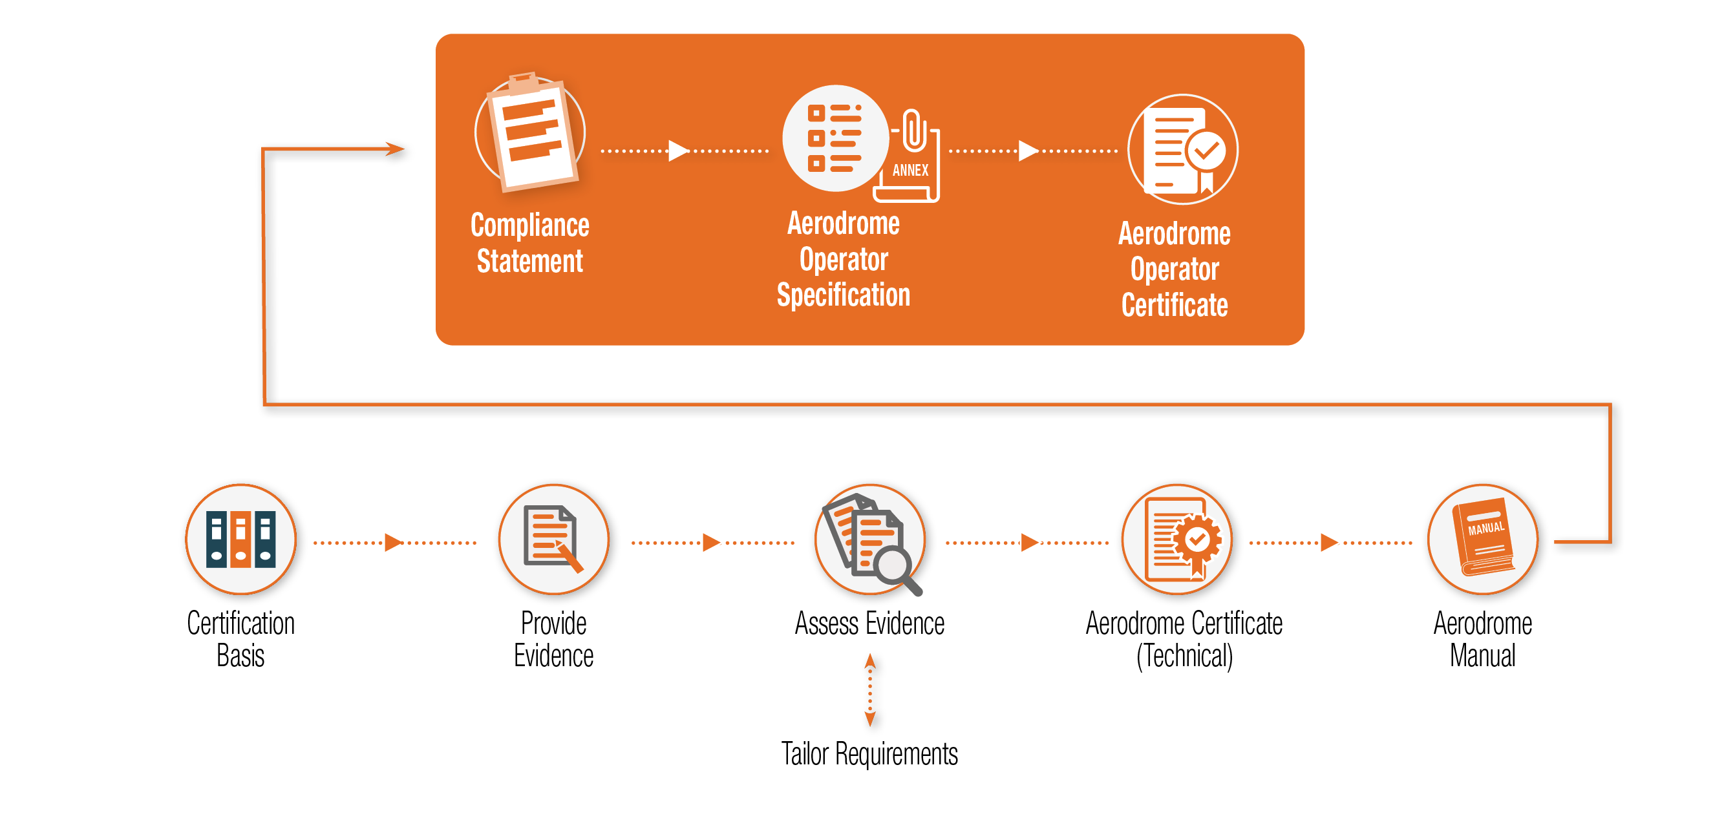
DASA 139 Artefacts Processes
Notes:
This diagram shows the significant processes and artefacts of the DASR 139 implementation.
Two terms that are potentially confusing are:
Certified aerodrome: is an annex to an Aerodrome Operator Specification.
Aerodrome certificate: A technical document that states the aerodrome meets the design requirements matching the certification basis, plus or minus tailoring requirements.
To have a certified aerodrome, all steps in this diagram must be completed. That does not mean you start at CB work through to AD OPR CERT. Elements may completed independently.
The solid orange box can be completed without an annex an you have AD OPR CERT issued but at that point they will not be operating an aerodrome under DASR 139.
The AD MAN can be pulled together although it will not be finalised until there is aerodrome certificate because parts of the certificate go into the manual.
You do start at the CB and go through the process to get to certificate.
Each certified aerodrome will be a separate annex to the Aerodrome Operator Specification.
To complete an annex you will require a Compliance Statement and an AD MAN.
This is not a static system. There will be changes once the initial process have been completed and the initial artefacts have been issued. Personnel changes, project implementation, updates to plans and many other changes will drive amendments. Not all changes on the bottom line will cause a change on the top line. We need to be smart about what info is recorded. A PMKeys position number vice an individual name will generally be more enduring, for example.

Slide 11
DASA 139 Aerodrome Operator
Cert AD must be operated by an AD OPR to approved STDS and procedures, to defined level and scope
AD OPR submits a Compliance Statement (CS) for approval
AD OPR retains responsibility
  Routine oversight of DASR 139 compliance
AD OPR have arrangements in place to achieve specific tasks by qualified personnel or organisations
The Aerodrome Operator does not subordinate or undermine command accountabilities. ACAUST/COMD FORCOMD/COMAUSFLT retain accountability for capability and safety decisions.
Notes:
The four bullets are AD OPR responsibilities.
DASR do not impact the chain of command. Recall the closing discussion about DASR and unless a command clearance is issued they cannot issue direction outside of DASR scope.

Slide 12
Aerodrome Operator Specification
AD OPR organisation name
Identify HTA and other key appointments
Evidence of SMS
Evidence of QMS
Annex for each aerodrome:
  Evidence of ADCERT status with limitations and conditions
  Key AD/base management and safety appoints
  AD Manual
  AD management arrangements
  Evidence of SMS
  Evidence of QMS
Notes:
This document is issued by DASA and provides the justification for issue of an AD OPR Certificate.
There is an annex for aerodrome controlled by an AD OPR.
A CS with an AD MAN is the required evidence for issue of Aerodrome Operator Specification.

Slide 13
Aerodrome Operator Compliance Statement
CS is used to apply for or amend an approval – dynamic document
CS content
  AD OPR organisation name
  AD OPR location
  Evidence of AD/s certification status and limitations/conditions
  HTA
  Key AD appointments
  AD Manual
  SMS
  QMS
  Statement of compliance
Notes:
This is a dynamic document used for initial issue and amendment of the Aerodrome Operator Specification.
The use of PMKeys position vice a name will generally reduce amendment requirements.
The single line of AD MAN is the biggest element of the CS and we expect it to a ref to an Obj ID or equivalent.

Slide 14
Aerodrome Operator Organisational Structure
AD OPR to define organisational structure
AD OPR org consist of ops, maint and engr:
  AD OPR MGR
  ‘Chain of Command’ including an AD MGR
  Qualified pers
  HTA
  Key pers
  Sufficient and suitable facilities
  AD management arrangements
  SMS
  QMS
Notes:
This is an expansion of ‘Key AD appointments’ of the previous slide.
Previous comment re PMKeys position number applies.

Slide 15
DASR.139.60 – Safety Management System
DASR.139.60 formalises the requirement for a safety management system
A safety management system will be required for AD OPR approval
DASM is the accepted corporate solution
Requires 4 components and 12 elements in line with ICAO
DASA is developing a SMS practitioner’s course
DASA is developing oversight and assurance methodology for SMS
15
Notes:
This slide provides an overview of requirements that will be covered in the practitioner course.
SMS requirements is specified at various levels. A single system across AD OPR is an option with pointers where required to that system. A layered approach is also an option. How an AD OPR implements their SMS is their choice as long as it compliant with DASR.

Slide 16
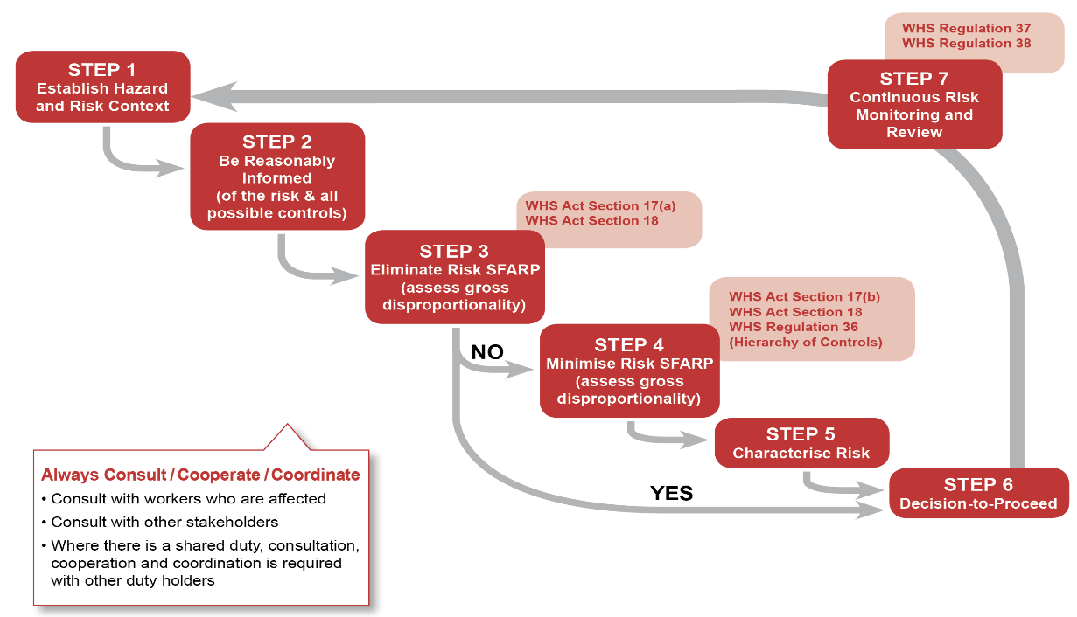
Safety Risk Management Process
DASA: Risk advice regarding defensibility and credibility
Command: Risk decisions regarding capability / safety
Legislatively compliant = risks minimised SFARP (temporal/contextual)
16
Notes:
While not going in to detail, the risk management expected to be utilised for risk management is the seven step process that will be covered on the practitioner course.

Slide 17
DASR.139.70 – Quality Management System
DASR.139.70 formalises the requirement for a quality management system
A quality management system will be required for AD OPR approval
QMS encompasses:
  Quality Planning
  Quality Assurance
  Quality Controls
  Quality Improvement
A ISO 9001 QMS is not required, but could be a standard used for guidance
Notes:
Like the SMS QMS implementation is flexible but must be compliant.
ISO 9001 is one option but others are viable.

Slide 18
Aerodrome Manual content
AD Org & MGMT
Master contact list
AD CB & non compliances
Ref pavement strength
Public info
ARFF
AD Emerg Plan
Wildlife Hazard Mgmt Plan
Low Vis Proc
Obstacle Data Coverage
FOD
AD Service & Tech Insp
AD description
AD Security
Auth appts to amend OIP
AD works Safety
Dev must approved by AD OPR and recorded
Notes:
An AD Man is not new artefact.
A couple of have had a look at what is out there today. Subjectively, on a limited sample we considered around 70% compliant to DASR 139, stand fast currency. Some of content appears to be in need of a refresh, which would be required regardless of the regulatory system they fall under.

Slide 19
Aerodrome Certification

Slide 20
DASR 139.80 - Aerodrome Certification Activities
Define Operating Intent
Develop/ Update SOI/ SOIU/ OSI
Aerodrome’s SOI/ SOIU/ OSI purpose and contents
Authority Agreement
Develop Certification Program Plan (optional)
Certification Program Plan purpose and contents (Optional)
Understand SOI/ SOIU/ OSI – operating context for AD
Aerodrome Design Standards and Tailoring of Standards
Establish means of compliance
Define and Authority-agreed CB (139.80.A(1))
Design Aerodrome
Design and construct aerodrome iaw. Authority-agreed CB
Generate and collate compliance demonstration evidence
Compliance Demonstration
Demonstrate Compliance (139.80.A(2))
Generate and collate compliance demonstration evidence
Addressing non-compliances/shortfalls against Authority-agreed CB
Document compliance demonstration evidence
Declaration of Compliance
Military Aerodrome Certification Review Item (MACRI)
Declare Compliance (139.80.A(3))
Submission
Support continued compliance (139.80.A(4))
Apply for Aerodrome Certificate
Confirm arrangements to support continued compliance and continuing safe operations.
Support continuing safe operations (139.80.A(5))
Certification
Authority review of compliance evidence (non-exhaustive)
Issue Aerodrome Certificate
Maintain Certification
Changes to Aerodrome Certification (DASR 139.80.B)
Re-certification of aerodrome for major changes
Aerodrome maintenance program information to support certification
Aerodrome support personnel competency details to support certification
Maintenance of Aerodrome (DASR 139.90)
Personnel Competency (AUS) (DASR 139.100)
Notes:
This diagram illustrates the individual certification activities – the relevant regulatory reference as well as the modules that will cover each of the steps.

Slide 21
Defence Aerodrome Design Requirements
Defence aerodrome design requirements are identified in AAP 7001.054 Airworthiness Design Requirements Manual (ADRM), Section 6
Aerodrome Type | Applicable ADRM Chapter | Baseline Aerodrome Design Standard
Land based aerodromes | Section 6, Chapter 2 | Civil Aviation Safety Authority (CASA) Part 139 (Aerodromes) Manual of Standards 2019 (MOS Part 139) (September 2019), including the MOS Part 139H - Standards Applicable to the Provision of Aerodrome Rescue and Fire Fighting Services (MOS Part 139H) (January 2005).
Land based heliports | Section 6, Chapter 3 | International Civil Aviation Organisation (ICAO) Annex 14 Aerodromes Volume 2 Heliports (July 2013, inclusive of amendments 6, 7 and 8 – Nov 2018).
Shipborne heliports | Section 6, Chapter 4 | Australian Defence Force Maritime Materiel Requirements Set - DEF (AUST) 5000 - Volume 11 Ship Aviation Requirements (November 2017) for the Royal Australian Navy (RAN). (a collection of requirements and standards)
Notes:
Contents
Other aerodrome design standards (standards for land and ship-borne heliports.

Slide 22
Tailoring Design Requirements
Establishing a CB involves defining a set of design requirements, starting with the appropriate ADRM, Section 6 chapter and tailoring this standard to meet an aerodrome’s operating context (SOIU/OSI).
Tailoring in this context for establishing a CB may involve:
  Removing requirements that are not applicable to the aerodrome’s operating context (i.e. NVG requirements as ‘Not Applicable’).
  Developing and using a special detailed technical requirement (i.e. bespoke requirement) that addresses a unique aspect of the aerodrome that is beyond the scope of recognised standards.
The CB established at the beginning will be a provisional CB to be approved by the Authority

Slide 23
Compliance Demonstration Overview
Once a provisional CB has been established, compliance demonstration involves demonstrating, through the production of evidence, that the design and construction of the aerodrome complies with the requirements in the CB.
A compliance demonstration is…
  An engineering decision that the design and construction of the aerodrome satisfies the approved CB requirements
  Based on relevant objective quality evidence
  Undertaken by a competent agency or individual
  Relevant to the operating context of the aerodrome
  Ensuring the designers/contractors have provided the depth of evidence a reasonable engineer would expect to demonstrate compliance with a requirement
DASA must be satisfied that compliance with the CB has been ensured by the Applicant in order to certify the aerodrome and provide any timely recommendations to the Aerodrome Operators/ Force Commanders.

Slide 24
MACRI Overview
During compliance demonstration activities shortfalls/ non-compliances against the CB design requirements may be identified.
  Non-compliances against Authority-agreed CB should be examined for impact to certification and safety of flight operations.
Where it is not reasonably practicable to change the aerodrome design OR where evidence cannot be generated to demonstrate compliance, the shortfall is to be addressed using the Military Aerodrome Certification Review Item (MACRI) process – either an Equivalent Safety Finding or Exception MACRI.
The MACRI process is employed to support Commanders and Managers in assessing risks to safe flight operations at an aerodrome, arising from non-compliances or shortfalls against the CB using the SRM process. The MACRI provides a consistent mechanism for assessment and independent assurance.
  Tech and Op assessment
  Risk approval both AD OPR and affected MAOs

Slide 25
Declaration of Compliance
The declaration of compliance is made by the Applicant.
The Applicant is declaring that:
  the Design meets the Certification Basis
  the Construction meets the Design
  all issues are addressed
  continued and continuing aspects of the regulation are addressed
  the Safety Program has captured and managed all credible Hazards and associated risks
Declaration of compliance can only be completed:
  Once compliance has been shown against ALL requirements in the Authority-agreed CB and
  approval of all MACRIs
Declaration can be made in the Aerodrome Certification application form.
  The CB and a list of the evidence demonstrating compliance is to be provided with the application form
  The Authority must be given access to all compliance evidence referenced in the CB

Slide 26
Arrangements for Continued Compliance with CB
Arrangements (systems and procedures) should be implemented to:
Retain all relevant design information, drawings and test reports; including inspection records for the aerodrome in order to provide the information necessary to ensure the continued compliance to the aerodrome certification basis, and conditions for safe operation of the aerodrome.
Manage the configuration of the aerodrome design.
Collect, investigate and analyse reports of and information related to failures, malfunctions, defects or other occurrences which might adversely affect safe operation of the aerodrome, to implement corrective action if warranted.
For initial certification:
    Applicant is to establish and provide evidence of these systems and procedures.
For maintenance of Aerodrome Certificate
    Aerodrome Operator is responsible for continued implementation and monitoring of these systems and procedures.

Slide 27
Continuing Safe Operation of the Aerodrome Operation of the Aerodrome
The Aerodrome Operator is responsible for ensuring that the aerodrome, at any time in its operating life, is in a condition for safe flight operation. However, for the Aerodrome Operator to execute this responsibility, it should be reliant upon information and procedures that are the domain of the aerodrome designer.
Aerodrome Designer
Aerodrome Operator
Aerodrome is in a condition for Safe Flight Operation at any time in its operating life.
Provides Information and Procedures
Documents that describe specific scheduled maintenance task and their frequency of completion
Descriptive data and accomplishment instructions that enable inspections, processes and procedures necessary to keep the aerodrome in a condition for safe flight operation.
Ensures

Slide 28
DASA Independent Assurance for Certification
CB
  Complete set of requirements based on ADRM Chapter
  Justified Tailoring (for removal in line with SOIU/OSI or additions)
MACRI
  Robust justification of capability imperative
  Tech and Op assessment
  Robust SRM applied
  AD OPR and MAO approval
Application
  Non-exhaustive review of Compliance Evidence
  Declaration of compliance made – complete

Slide 29
DASR.139 Remaining Areas
DASR 139.80.B – Changes to Certification
  Same process as Cert Process, just tailored for size / complexity
DASR 139.90 – Aerodrome Maintenance
  Maintenance Program – have and do
DASR 139.100 – Personnel Competency
  competent, qualified and authorised – AD OPR, Cert Declaration, Maintenance

Slide 30
What is coming…
This year …
  Education and planning
Aerodrome Operator certification
  CY 21/22 (four AD OPR)
Aerodrome certification
  CY 21/25 (all Defence Certified aerodromes)

Slide 31


Slide 32
Course Content
Module 1 – Course Overview (ACPA-SA, 15min)
Module 2 – Flight Operations Terminology and Application (ACPA-SA, 20min)
Module 3 – Defence Aviation Safety Framework (DASF) (ACPA-SA, 30min)
Module 4 – Accountability (ACPA-SA, 90min)
Module 5 – Flight Operations / ASMS Regulations (ACPA-REGS, 90min)
Module 6 – Quality Management Systems (ACPA-SA, 30min)
Module 7 – Airworthiness Regulations (Who and How Long TBA)
Module 8 – Risk Based Decision Making (TBA, 90min)
Module 9 – Certification – Oversight and Enforcement (ACPA-SA, 40min)
Module 10 – DASHA (ACPA-SA, 20min)
Module 11 – Education and Tools (ACPA-SA, 30min)
Module 12 – Current Discussion Points (ACPA-REGS, 60min)
Notes:
Refer to learning outcomes required for the applicable course / audience.

Slide 33
Aerodrome Certification Process
Notes:
Whilst the previous slide illustrated the individual certification activities - this slide illustrates that business process flow that ties all of those
The following modules will cover each of these processes in detail

Slide 34
Systems Covered by Baseline Standard
Systems and functions covered by the baseline design standard include:
  The physical characteristics of the movement area.
  Aircraft arresting systems.
  Obstacle restrictions and limitations.
  Visual aids for the movement area and other areas (e.g. aerodrome markings, markers, signals, wind direction indicators).
  Visual approach slope indicator systems.
  Visual aids provided by aerodrome lighting systems.
  Communications, Navigation, Surveillance (CNS) and Meteorological (MET) facilities.
  Earthing points
  Light aircraft tie-down facilities Reference code systems.
  Radio communication facilities.
  Aircraft Rescue and Firefighting (ARFF) requirements
  Access to an aerodrome, including requirements relating to fencing.
  Design requirements to avoid the creation of hazards from aircraft propulsion systems.

Slide 35
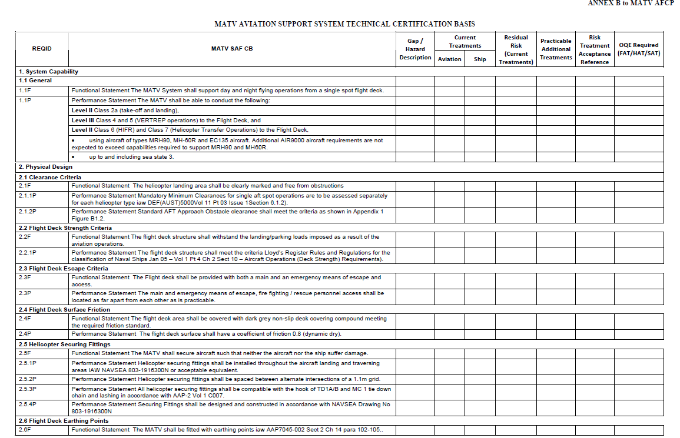
Example CB

Slide 38
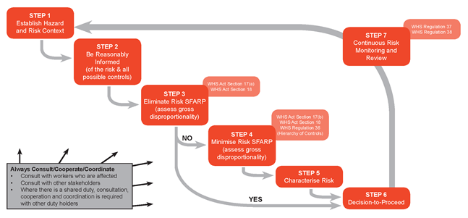
7 Step SRM Process

Slide 39
Information to Support Continuing Safe Operation of the Aerodrome
Information that supports continuing safe operation of the aerodrome includes:
  Documents that describe specific scheduled maintenance task and their frequency of completion
  Descriptive data and accomplishment instructions that enable inspections, processes and procedures necessary to keep the aerodrome in a condition for safe flight operation.

