Slide 1
Directorate of Aviation Operations (DAVNOPS)
Town Hall – DASA Safety Management Systems Transition
26 June 26
Objective: BP57553520
SQNLDR Joshua Hamson
DAVNOPS SMS Team (SO2 SMS 4)
Notes:
Opening Comments: GPCAPT Nicolas Pausina
Presenter(s): WGCDR Brian Brown DASA DAVNOPS DD-SMS
SQNLDR Joshua Hamson SO2 SMS4
MAJ Oliver Hulin SO2 SMS3
Closing Comments: GPCAPT Nicolas Pausina
Town Hall Admin:
Remain on ‘MUTE’ unless speaking.
Save your questions until the end – There will be sufficient time.
This presentation will be made available following the Town Hall through a DASA Newsbreak and on the DASA SMS webpage.
If you have specific questions that are not suitable for this forum, please forward them to the DASA-SMS inbox
Points to be aware of:
‘Command-led’ is outdated terminology. There are sections of the DASM that were intended to support Accountable Managers, and were owned by AMs. As they did not directly support DASR SMS requirements, these are not being re-located in future DASA products, but can be adopted by AMs if they wish to.
“Regulated Community” and “DASC” are outdated terminology. The are the Safety Community, Aviation Safety Community, or Approved Organisations.
Avoid KPIs and other Quality/Command language. This is a focus on Safety Management Systems in Aviation, terms used for other areas of practice will only confuse the audience.
“Authorised Organisation” is outdated terminology. They are only “Approved Organisations”.

Slide 2
Opening Comments
GPCAPT Mark Masini

Slide 3
Aim:
Engage the Aviation Safety community on the February 2026
release of DASR SMS.
Notes:
Verbatim:
As part of our commitment to the SMS Transition Change Management Plan, the aim of these monthly town halls is to…
Engage the Aviation Safety community on the February 2026 release of DASR SMS.
These Town Halls are designed to provide you with updates on the progress of the SMS Transition and provide Education and Training to the Safety Community on general SMS principles.
If you have a question, please wait until the appropriate ‘Questions’ slide to ask. The intended timing of this presentation is 30 minutes, leaving the final ½ hour for Q&A.

Slide 4
Scope
DASR SMS Transition
  AC 001/2026 – DASR SMS Transition and Change Management Arrangements
  DASR SMS Changes
  Transition timeline
  Demonstrating compliance
  Withdrawal of the DASM
Element 3.2: Management of Change
Other Updates
  DFSB Defence Flight Safety Manual (DFSM) – Status Update
Notes:
Verbatim:
The scope of this Town Hall shares a lot of similarities to previous Town Halls – This is to cater for anyone where this is their first time viewing the Town Hall as well as reinforcing the requirements for transition.
First up, we will discuss Advisory Circular 001/2026, which covers the DASR SMS Transition and Change Management Arrangements.
This will be followed by a quick overview of the changes to DASR SMS,
The transition timeline and expectations of what is required over this period.
DASA’s expectations for demonstrating compliance.
And the withdrawal of the DASM.
We then will cover a new topic – the Management of Change, one of the focus areas for the SMS team for this year.
We will then close with a brief update on DASR GR.40 – Occurrence Reporting.

Slide 5
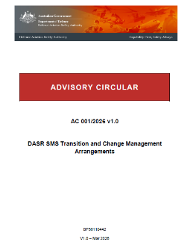
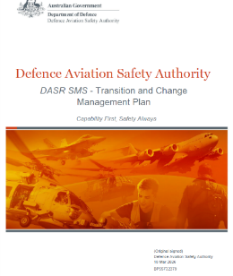
SMS Transition and Change Management Plan
AC 001/2026 DASR SMS Transition and Change Management Arrangements
  SMS ‘Town Halls’
  MAO SMS / QMS reviews and workshops
  Transition education and training (inc. FAQs)
  Pause on SMS findings (except Level 1).
  Change Management Plan
  DASM-DASPMAN cross-reference matrix (live document)
Notes:
In April, DASA released Advisory Circular 001/2026. This AC explains the arrangements for the transition of DASR SMS and included a Change Management Plan to ensure DASA provides the appropriate support to the safety community during this transition period. For those of you who wish to know more on this, I strongly encourage you reading the AC to understand the purpose, intent and expectations behind the transition.
That said, from this AC, DASA has committed to the following actions over the transition period to support the safety community:
SMS ‘Town Halls’. Monthly. Contains additional topics. Opportunity to ask questions.
MAO SMS / QMS reviews and workshops. DASA DAVNOPS-FLTOPS. QMS and SMS reviews. Assistance not Findings.
Transition education and training. Town Halls, FAQs, Vol 3 Chap 14. Developing additional GM. Opp. to ask questions.
Pause on SMS Findings. Transition period. Focus on education and training. Pause on all but LVL 1 Findings.
Change Management Plan. DASA Change Management Plan in AC. Source of these Town Halls.
DASM-DASPMAN cross-reference matrix (live document). DASM/SMS merger is the biggest change. Document available to assist.
GM – Vol 3.
Reg/AMC – Vol 2.
Investigation & Reporting – DFSB Manual.

Slide 6
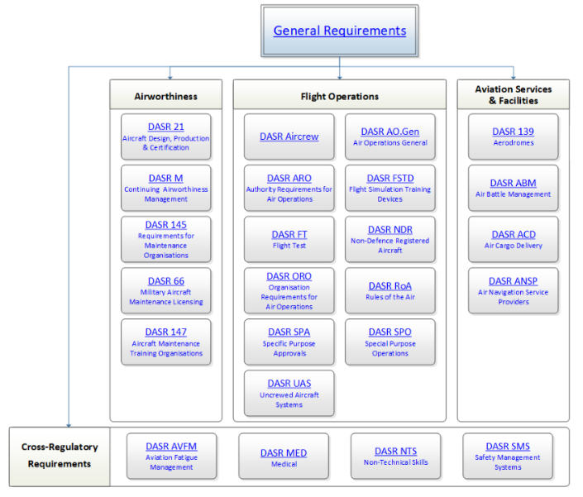
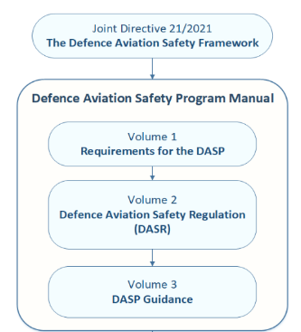
DASR SMS Update - Regulation, AMC & GM
  DASPMAN Volume 2 – DASR SMS
    Regulation and AMC
    ADF & Non-ADF flexibility
  DASPMAN Volume 3 Chapter 14
    129 Pages of GM
Notes:
Key Message: Demonstrate what the changes look like.
Presenter:
Discuss Vol 2 at a high level including the following:
Removal of most GM from the Regs.
The creation of alternative AMC where ADF and non-ADF requirements vary.
Note the increased prescription for each Element and its AMC.
Discuss Vol 3 at a high level. Demonstrate the following:
The size of the GM – approx. 129 pages. NOTE: DASM was 284.
Note that this includes a detailed breakdown of the 7-Step Risk Assessment Process pp. 61-79, which will replace AC 003/2018 at the end of the Transition Period.

Slide 7
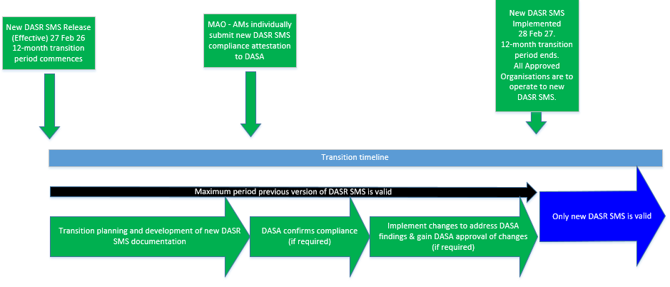
SMS Transition Plan - Transition Timeline
Notes:
Verbatim:
We are now 4 months into the 12 month transition period which began on the 27th Feb this year. The transition was kicked off by the release of the updated DASR SMS and its supporting guidance material in Volume 3 of the DASPMAN.
Over this period, organisations are expected to review their SMSs against the new requirements, update them and send them back to DASA with an attestation of compliance – I’ll talk about this in more detail in the coming slides.
Once DASA receives compliance attestations, we will review them, let you know if any further changes are required with the aim of having all organisations transitioned by 28 Feb 2027.
At this point in time, the DASM is withdrawn, AC 003/2018 – Risk Management in the Aviation Safety Program is withdrawn and the new DASR SMS comes into effect.

Slide 8
SMS Transition and Change Management – Demonstrating Compliance
Things for you to do:
  Engage with DASA early.
  Get familiar with ‘New Look’ DASR SMS regulation and AMC.
  Use the PSOE Evaluation Tool to identify gaps.
  Understand the potential workload (and resources required) to achieve compliance (eg relied on references to DASM or AC 003/2018?).
  Plan the transition.
  Update SMS documentation and artefacts.
  MAO-AMs – Submission of compliance evidence to DASA for evaluation and transition to the new regulation.

Slide 9
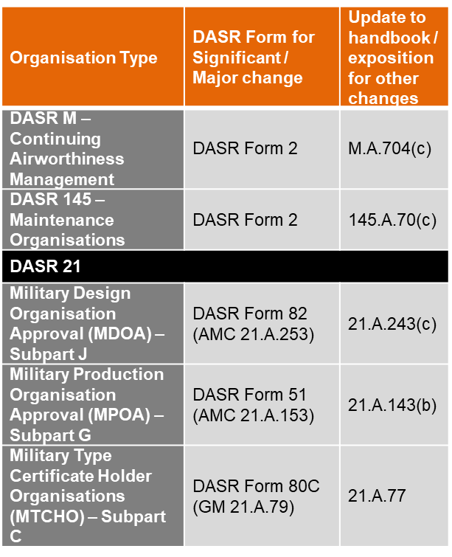
Transition Process – DASR 21, 145 and M Organisations
– Always contact your DASA Desk Officer and confirm the process for your organisation –
Typical process (DASR 21, 145 and M Organisations):
Review and update extant SMS documentation for compliance with the new SMS requirements.
Changes should be assessed to determine if they represent a significant change.
  Significant / Major: Submit the appropriate DASR Form (see table) with supporting documentation.
  Not Significant / Minor: Approve internally and supply DASA with copies of the updated SMS Documentation.
Note: M & MTCHO’s require integration with the MAO/Entp.
Notes:
Verbatim:
This process has received a bit more clarity for DASR 21, 145 and M organisations.
Before I discuss this, there is a Caveat – This page represents a typical process. Always contact your DASA Desk Officer to confirm if this applies to you.
So for airworthiness organisations and DASR 21, the SMS transition will ultimately result in a review and update of your current Exposition or Handbook and associated underlying documentation. This means that standard amendment processes apply:
If the changes made fit within your current definition for a non-significant or minor change to the Exposition or Handbook, follow your internal approval process and send DASA copies of the updated documentation.
If the changes made are considered ‘Significant’ or ‘Major’, you will need to submit the corresponding form in the right hand table for DASA’s approval.
Again, contact your Desk Officer to confirm that this is the process for you.

Slide 10



SMS Transition Plan – Withdrawal of the DASM
The DASM will be formally withdrawn 28 Feb 2027.
It may continue to be used as the ‘corporate solution’ during the transition period.
No information from the DASM will be orphaned – redirected to:
  DASR SMS Vol 2
  DASR SMS Vol 3
  DASA Webpage
  Defence Flight Safety Manual (reporting and investigations)
  SMS Handbooks
DASM to DASPMAN Vol 2 & 3 cross reference matrix
Changes to DASR SMS (Feedback welcome)
  DASPMAN Vol 2 – DASR Change Proposal (Form 111) (DASA website)
  DASPMAN Vol 3 – email (dasa.asms@defence.gov.au)
  FAQ
DASM
With Effect From 28 Feb 27

Slide 11
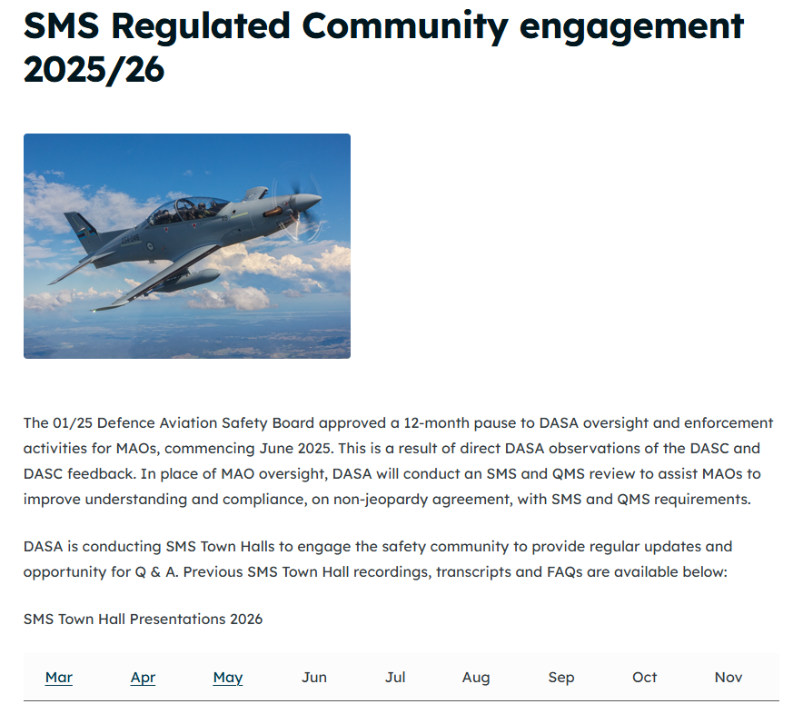
SMS Transition - Resources
Transition resources will continue to be updated on the DASA Safety Management Systems webpage.
If you have issues accessing these resources, contact us at: dasa.asms@defence.gov.au

Slide 12

Management of Change - Introduction
Changes can control risks, but can also introduce risks.
  Software or hardware upgrades/roll-backs
  Personnel in/out
  Operational environment or tempo
  Updated Regulations and OIP
Changes have the potential to create Latent Conditions.
Even small changes can have a cumulative effect on safety through ‘Practical Drift’.
Notes:
Latent conditions are the hidden, dormant system weaknesses that have been present for some time, often unnoticed until they interact with active failures to cause harm.
Practical drift is the slow, often unnoticed deviation of daily work practices from formal rules, policies, or procedures. Also known as procedural or safety drift, it happens when workers adapt, cut corners, or create shortcuts to get a job done more efficiently.

Slide 13
DASR SMS Requirements
A…
Process
…that…
Identifies
Hazards
…and…
Manages Risks
From the point of view of DASR SMS, the Management of Change (3.2) is an extension of
Hazard ID (2.1) and Risk Assessment and Mitigation (2.2).

Slide 14
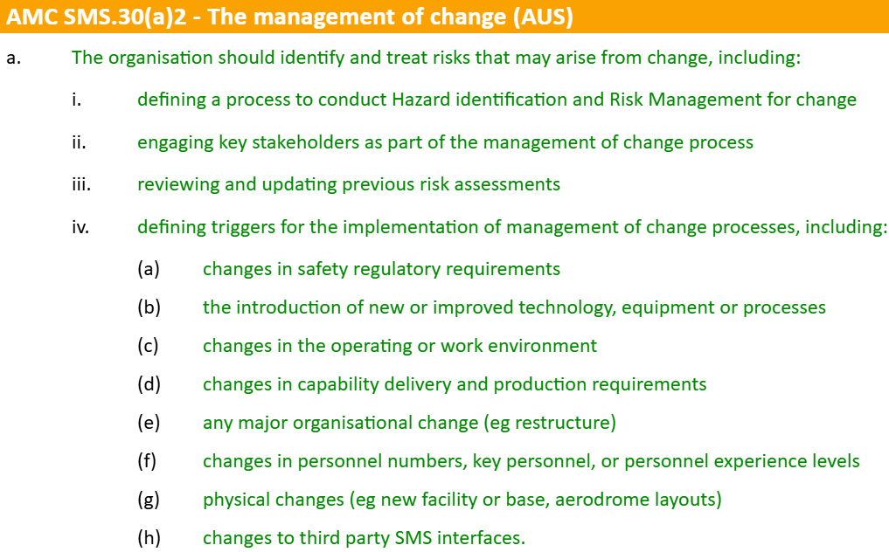
DASR SMS Requirements
Defined Process
Hazard ID & RM
Stakeholders Eng.
Reviews Risk Ass’ts
Defined Triggers
DASPMAN Vol 3 Chap 14
Notes:
From the perspective of DASR SMS, there are several features that we will expect your MoC process to include.
First. It needs to be defined. The generic process in the DASM is satisfactory but your OIP will need to restate this and contextualise it for your organisation. For example, you need to tell us how/where the records for the management of change processes will be stored. Who will typically undertake the process for different types and how implementing and reviewing actions will be managed. Perhaps they will all be covered in a monthly meeting and captured in its minutes, perhaps the process will be centrally managed in a form or software package. It doesn’t matter to us how, but it does need to be a defined process.
Second. It must include hazard identification and risk management activities for aviation safety hazards. This could lean on your existing processes under Element 3.2 or be integrated in the defined process.
Third.

Slide 15
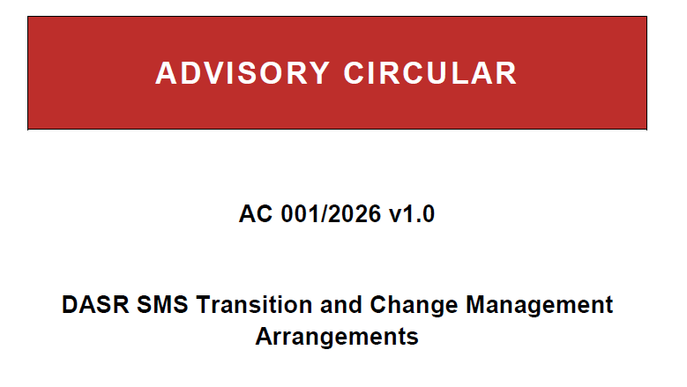
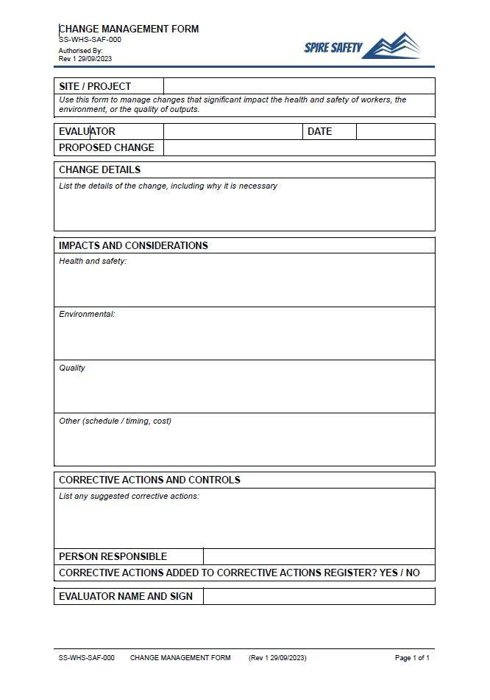
What should it be called?
It can take many forms or names:
  A Unit Succession Plan.
  Part of Project Management Plan.
  A Brief.
  Document Change Proposal
  Change Management Form
  An Advisory circular.
Whatever they are called, make sure your OIP identifies what they are and how they are managed.

Slide 16

The Management of Change Process
DASPMAN Vol 3 Chap 14
Communicate & Consult
  Engage stakeholders, build acceptance.
Develop Case for Change
  Define need, benefits and criticality
Risk Assessment & Planning
  Identify hazards and risks (new and existing)
Phased Plan & Approval
  Who, what, when, how & Decision to proceed
Example: Posting Cycle
(Major Turnover Event)
Implement, Monitor & Review
  Execute with flexibility and track performance
Notes:
Communicate and consult. Communicating changes and potential impacts is fundamental to the effectiveness of the management of change. In preparing for change:
consult with personnel and stakeholders (internal and external), invite participation in the development of any change solutions, including their timing, and mitigation of potential impacts
2. early communication, engagement and involvement of stakeholders at all levels will normally improve the way the change is perceived, implemented, accepted, and will likely remain enduring.

Slide 17

The Management of Change Process
DASPMAN Vol 3 Chap 14
Consult early with internal and external personnel regarding:
  Timings
  Impacts
  Mitigations
Example:
- Defence People Group (External)
- Headquarters (External)
- Team Leads (Internal)
- Key Personnel (Internal)
Early engagement is important for a successful change.
Communicate & Consult
  Engage stakeholders, build acceptance.
Develop Case for Change
  Define need, benefits and criticality
Risk Assessment & Planning
  Identify hazards and risks (new and existing)
Phased Plan & Approval
  Who, what, when, how & Decision to proceed
Implement, Monitor & Review
  Execute with flexibility and track performance
Notes:
Communicate and consult. Communicating changes and potential impacts is fundamental to the effectiveness of the management of change. In preparing for change:
consult with personnel and stakeholders (internal and external), invite participation in the development of any change solutions, including their timing, and mitigation of potential impacts
2. early communication, engagement and involvement of stakeholders at all levels will normally improve the way the change is perceived, implemented, accepted, and will likely remain enduring.

Slide 18
The Management of Change Process
DASPMAN Vol 3 Chap 14
Consider the criticality of the change.
  Impact on Org. & 3rd parties
  Impact on planned activities
  Is it even necessary?
Consider availability of data
  Key milestones
  Existing/historic information
  Early warning signs
Example:
This is a forced change but still consider:
  Corp. Knowledge
  Safety position requirements
  Existing action items
Data:
  Stay-go lists
  Reservist days
  Extensions
Communicate & Consult
  Engage stakeholders, build acceptance.
Develop Case for Change
  Define need, benefits and criticality
Risk Assessment & Planning
  Identify hazards and risks (new and existing)
Phased Plan & Approval
  Who, what, when, how & Decision to proceed
Implement, Monitor & Review
  Execute with flexibility and track performance
Notes:
Develop the case for change. Provide a compelling argument for the need for the change with a clear statement of benefits. If this is conducted adequately, it will answer many questions, concerns and perceptions. The case should take into consideration:
criticality of the change. How critical is the change, and what impact does it have on the organisation and third parties current and planned activities?
availability of data. What data and information are available that can be used to provide context to the change and suggest indicators of management of change success or failure? What data can be used to provide early warning of change plans going astray?

Slide 19
The Management of Change Process
DASPMAN Vol 3 Chap 14
This is a risk assessment and should include:
  consideration of personnel and SMEs available to assist
  stakeholders to be involved
  organisation processes and interfaces affected (eg documentation, training etc.)
  cumulative effects of the change or other changes
  how to manage the human dimension
Example:
DPG key personnel and their goals
Access to contractor and reservist assistance
# of personnel required to run the SMS
Corporate knowledge loss
Individual preferences
HO/TO Arrangements
Communicate & Consult
  Engage stakeholders, build acceptance.
Develop Case for Change
  Define need, benefits and criticality
Risk Assessment & Planning
  Identify hazards and risks (new and existing)
Phased Plan & Approval
  Who, what, when, how & Decision to proceed
Implement, Monitor & Review
  Execute with flexibility and track performance
Notes:
Conduct risk assessment and planning. Change may compromise the effectiveness of existing risk controls or potentially introduce new risks. All new hazards and risks can be processed in accordance with the 7SRM process. Management of change Risk Management should include consideration of:
availability of personnel and Subject Matter Experts (SMEs). Will the change be managed as a secondary duty or is it important enough to allocate dedicated personnel for a period of time? Are SMEs familiar with the change outcome required and potential impacts and effects? Are key personnel of the aviation community involved in the management of change activities (including individuals from external organisations where necessary)?
the stakeholders and impacts. This is an opportunity to define who should be involved in the management of the change. This could include individuals within an organisation or external stakeholders. Equipment, systems and processes may also be impacted, within the organisation and externally. A review of organisation processes and interfaces may be needed. The organisational system elements to be considered if enduring change include:
management commitment to the change, initially and on-going (for enduring solutions)
organisational design, accountabilities and responsibilities to enact and enforce the new behaviours for enduring effects and performance
training, mentoring and communication to stakeholders, initially and on-going (for enduring solutions)
policy, plans and process requirement changes
information technology, data and records requirements to bed-in the change
compliance, conformance and performance systems to continue to check that the change is effective and provide a closed feedback loop.
cumulative effects. Small incremental changes often go unnoticed, but their cumulative effect can be significant. What other changes are occurring or have occurred recently that could also impact the outcome of the change proposed, or vice versa? Cumulative changes might lead to the need for system reviews (eg a review of an aviation system’s Statement of Operating Intent and Usage (SOIU) for current validity prior to operational deployment or physical (ie hardware and software) changes).
the human dimension. Demonstrated by past performance in restructuring and adapting to different requirements where the failure rate is surprisingly high not because of strategy, but because of underestimating the human factor. Organisations should also consider the impact of the change on personnel. This could affect the way the change is accepted by those affected. Early communication and engagement will normally improve the way the change is perceived and implemented.

Slide 20
The Management of Change Process
DASPMAN Vol 3 Chap 14
Create a plan, with phases if needed.
  base it around milestones
  assign actions/tasks and due dates
  trace control measures to the Risk Ass.
  include communications plans
  Include a distinct ‘decision to proceed’ for the RMA and Change Authority.
Example:
Milestones: Stay-Go List final release, DPG unit succession meetings, Initial postings released, final postings released.
Tasks assigned for considering contractors and reservists and DPG offerings.
Define decision points.
Communicate & Consult
  Engage stakeholders, build acceptance.
Develop Case for Change
  Define need, benefits and criticality
Risk Assessment & Planning
  Identify hazards and risks (new and existing)
Phased Plan & Approval
  Who, what, when, how & Decision to proceed
Implement, Monitor & Review
  Execute with flexibility and track performance
Notes:
Prepare a phased plan. To provide a solid basis for change success, develop a phased plan that builds each phase on the success and lessons-learned of previous phases, and incorporates decisions of all earlier steps. The plan should define what is to be done, by whom, by when, and in what sequence, with assigned responsibilities, milestones, and when reviews are required. The plan should be tailored to the organisation, with the level of detail modified to suit complexity. Stakeholder communication strategies should also be defined, including how personnel will be engaged. To manage change-related risks, by eliminating so far as is reasonably practicable (SFARP), and if not reasonably practicable, minimising the risk SFARP, and to allow implementation to proceed, include an opportunity for both the Risk Management Authority and the change management authority to confirm and approve.

Slide 21
The Management of Change Process
DASPMAN Vol 3 Chap 14
Implement the plan, assuming flexibility with:
  continuous review and re-planning
  action tracking to completion
  personnel providing oversight
  metric tracking / internal auditing
Long term (ie post-change) monitoring and review as required. – Often Missed.
Example:
fortnightly team catch-ups,
monthly stakeholder meetings,
milestone meetings,
metrics for positions filled v vacant
ongoing assessments of candidates / options
Communicate & Consult
  Engage stakeholders, build acceptance.
Develop Case for Change
  Define need, benefits and criticality
Risk Assessment & Planning
  Identify hazards and risks (new and existing)
Phased Plan & Approval
  Who, what, when, how & Decision to proceed
Implement, Monitor & Review
  Execute with flexibility and track performance
Notes:
Implement the plan. Execute the agreed plan but remain wary of the pace of change and the momentum required to keep the tasks moving. Continuously review and re-plan as necessary to improve outcomes, this is a sign of management’s commitment to the change.
Implement monitoring and review. To assure the change has the desired effects, and remains enduring even through circumstance changes including postings, monitoring activities and data points should be established (eg targeted validation audits or performance data). Monitoring and review should continue until change plan assumptions have been tested, outcomes are expected and validated, unexpected side-effects have been dealt with, and the required change behaviours have become the new ‘norm’. On-going monitoring action may need to continue for some time.

Slide 22
The Management of Change – Expected Outcome
Identified in Policy
Defined in OIP
Carried out in Systems (eg Form)
Stored in Records (eg Obj)
Your Management of Change process may be a:
Brief Template
Form
Integrated feature in Hazard ID and Risk Man
Off-the-shelf software package
All of the above.
Communicated through Training & Education
Note: Management of Change policy may consider multiple domains such as Aviation Safety, WHS and QMS.
Notes:
Identified in Policy. Top level policy should outline the need for Management of Change processes and direct readers to the relevant Orders, Instructions or Publications.
Defined in OIP. Your Orders, Instructions and Publications then should define the process in sufficient detail that Management of Change activities and outcomes are repeatable including:
The systems in which it is carried out – For example you may have a form or template.
Where records related to the management of change are to be stored.
How education and training for the process will be communicated to relevant personnel.
Orange Box. As previously suggested, your Management of Change process may take many forms – Briefs, Forms, Integrated in RM systems, Software packages or a combination of all of the above.
As a final note for this slide. We have described the requirements of DASR SMS for the Management of Change, there may be other domains may also be considered in this process, such as WHS and QMS.

Slide 23
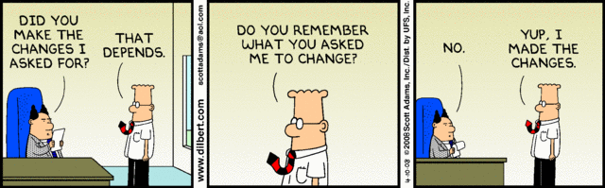
Management of Change - Summary
It needs to be a defined, formal, systematic process
When a change occurs that meets pre-defined criteria, the process is initiated
This process includes:
  Communication and consultation
  Developing a case for change
  Risk assessment and planning
  Phased plans and approval
  Implementation, monitoring and review
Why? – Identify hazards and manage Aviation Safety risks that may arise from change.
DASPMAN Vol 3 Chap 14

Slide 24
QUESTIONS
Email: dasa.asms@defence.gov.au
Internet: dasa.defence.gov.au/safety-management-systems

Slide 25
Defence Flight Safety Manual
    Part 1- Independent Investigations
    Conduct of DFSB Independent Investigations
    Requirements of the Defence Aviation Community during Independent Investigations
    Part 2- SMS Reporting and Investigations
    Policy, procedures and techniques for the community to perform Reporting within their SMS
    Roughly split between activity inside an SMS and outside of an SMS (SMS Investigations)

Slide 26
Defence Flight Safety Manual
Q3 2026
Q1 Feb 27
Q4 Nov 27
Publish the DFSM
DASR SMS compliance
1st DFSM Review (AL)
Revised DASPMAN Vol1 Chap5
DASM Withdrawn
DFSM in effect

Slide 27
QUESTIONS
Next SMS Town Hall – 31 July 2026
Notes:
Next town hall will be diving a little deeper into change management considerations.

Slide 28
Closing Comments
GPCAPT Mark Masini
Notes:
Purpose: This section is an opportunity for the Presenters to provide some basic background on the SMS update and rationale before launching into the Transition Plan. A high level view of changes will be included but the specifics are not the purpose of this Town Hall. Any detailed questions should be referred to DASA-SMS Inbox.

